Slide 1
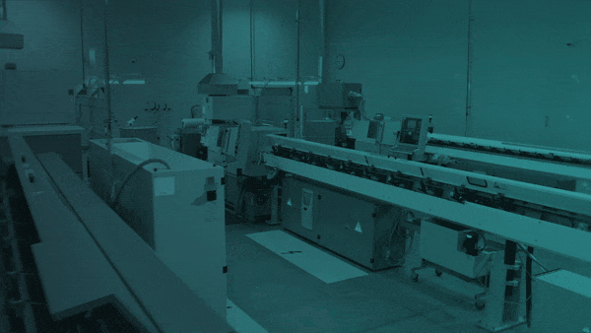

Data and AI Made Useful for the Front-Line
The information operators need to be high performers, available in real-time.

Slide 2
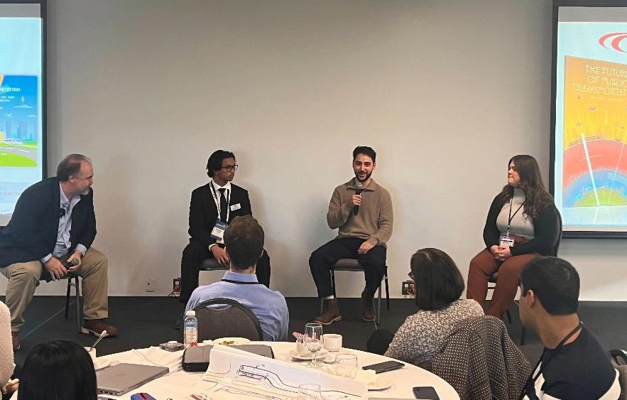
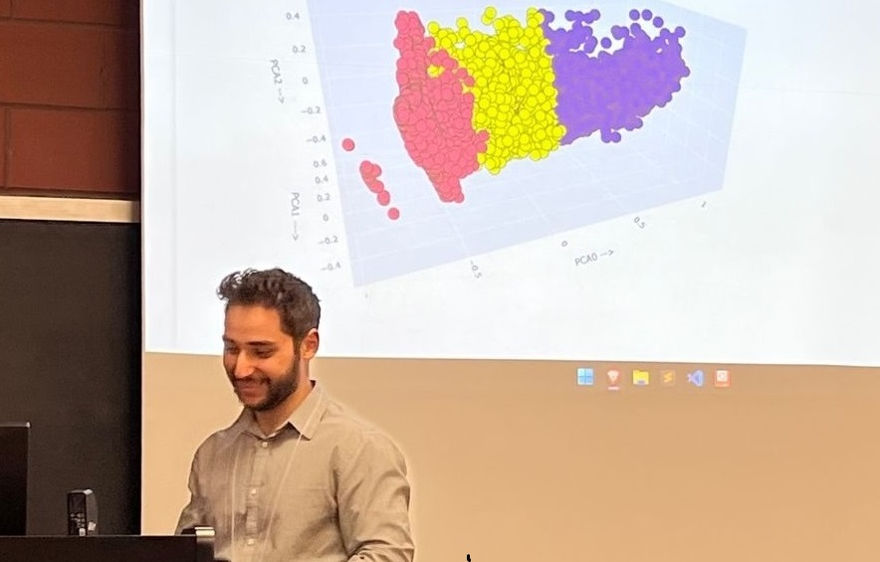
Joe
Youssouf
Data Scientist II
Oden Technologies
joseppy.ca
https://github.com/JYoussouf/slides/gdg-devfest-2024
Notes:
Thank Google Dev Group
Make Windsor a Tech Hub

Slide 3
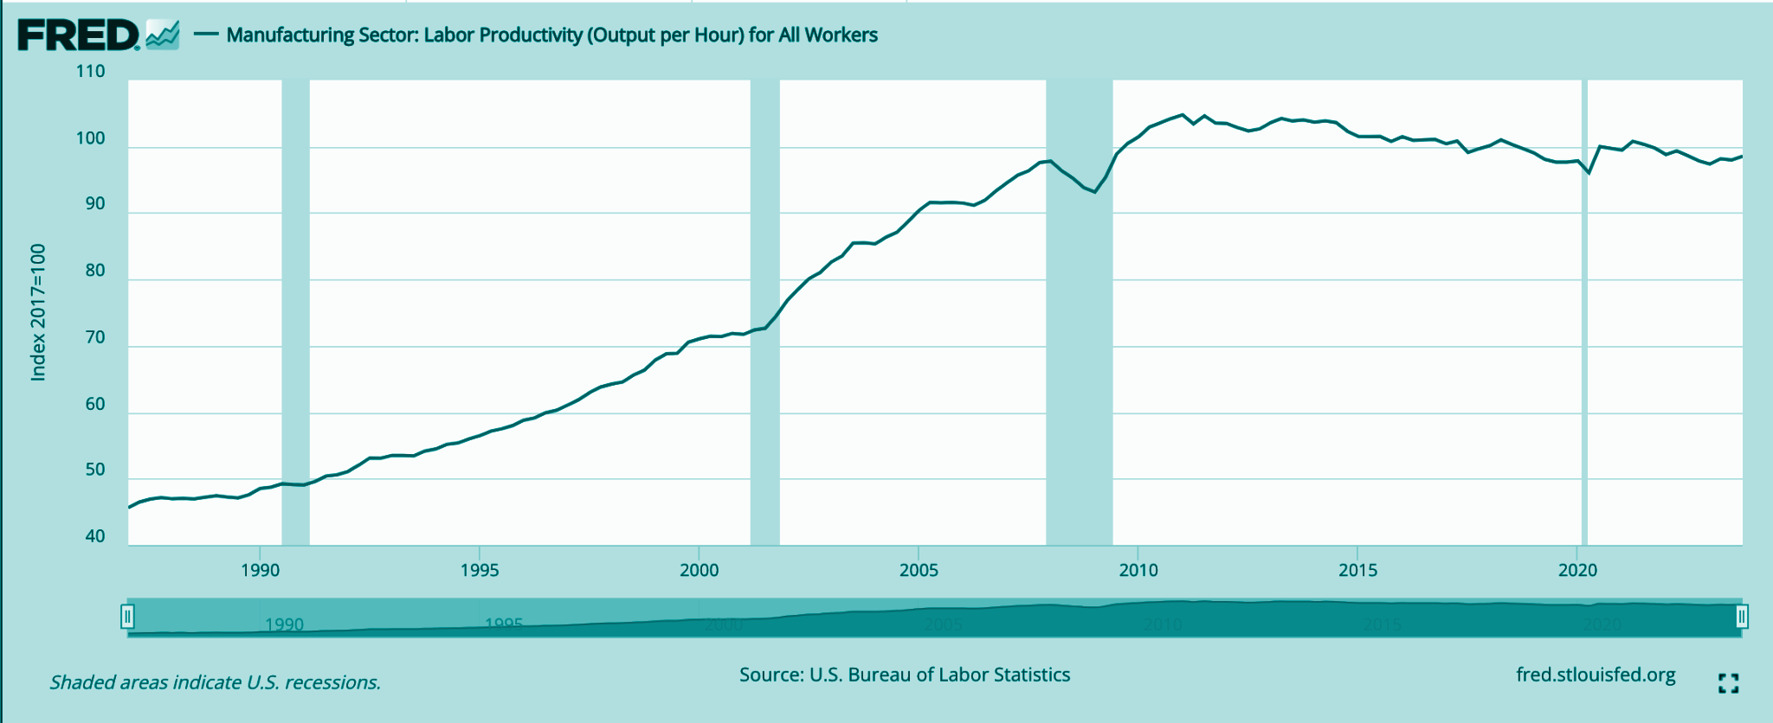
A Perfect Storm for Manufacturers
Manufacturing Labor Productivity (Output/Hr)
100
80
Index 2017 = 100
60
40
1990
2000
2010
2020
A Typical Manufacturer’s Workforce
 | 2018 | 2024
Average Tenure | 20 Years | 3 Years
Average Time in Position | 7 Years | 9 Months
Average 3-Month Retention Rate | 90% | 50%
Productivity Plateauing
Workforce Challenges
Demand & Asset Growth
Margin & Competitive Pressures
Sources: LNS Research, FRED, U.S. Bureau of Labor Statistics
‹#›
Notes:
Increased product complexity & variance
Smaller orders & higher number of SKU’s
Unstable workforce
Source: https://members.lnsresearch.com/research-library/research-articles/pathfinders-executive-event-future-of-industrial-work-presentation-slides

Slide 4




Front-Line Challenges
Dependent on Operator Experience
Decreasing Tenure
Losing Tribal Knowledge
Sources: LNS Research
‹#›

Slide 5
Bridging the Productivity Gap
Experienced Operators
Experienced Operators
P75
New Operators
P50
Productivity
New Operators
P25
Today
Tomorrow
Notes:
Before Process AI:
New Operators were historically underperforming the average production rates
Experienced Operators performed much stronger, but didn’t try to push beyond what they had been able to produce in the past for fear of causing issues
After Process AI:
New Operators now performed at close to the level of Experienced Operators from before, as they were given direct instructions on what settings to change to increase speed without negatively impacting quality
Experienced Operators now started pushing the boundaries as they had confidence that they could, resulting in them surpassing the previous artificial production ceilings

Slide 6


Empower the Front-Line
Real-Time AI Recommendations

Slide 7
$3,200,000,000
Projected impact on global GDP from manufacturing IoT over by 2031 ~ McKinsey, 2016

Slide 8

84%
of manufacturers are maintaining or increasing investment in Industrial Transformation (IX)
74%
of IX leaders are investing in AI/ML
4X
how much more likely industry leaders are to be investing in real-time data for the front-line vs. laggards
Sources: LNS Research: Lessons from Industrial Leaders, Future of Industrial Work Roundtable
Notes:
https://members.lnsresearch.com/docs/default-source/default-document-library/lns-research-exemplar-event-june-13-14-2023.pdf?sfvrsn=196b871_0

Slide 9
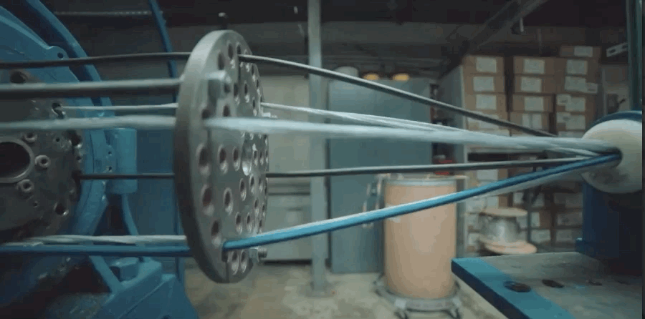
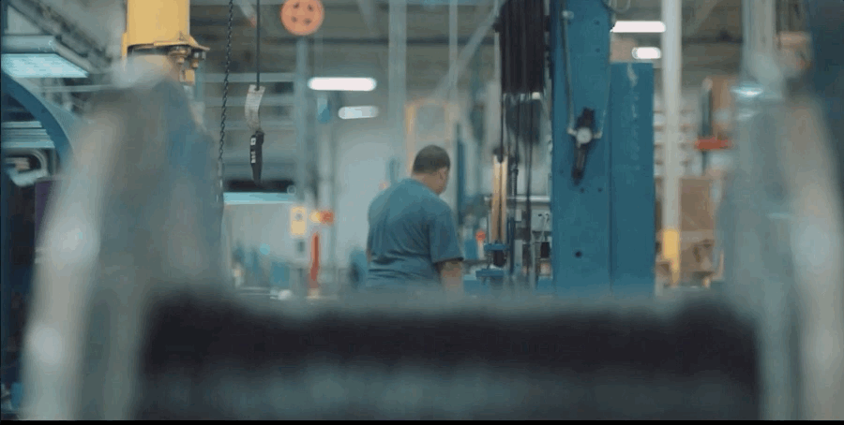
Oden’s
Customers
Medium to large manufacturers in plastics extrusion, injection molding, pipes, chemical, paper and pulp.
Process and Quality Engineers looking to centralize, analyze, and act on their data.
Plant managers who are looking to optimize logistics, output, and cost.
Notes:
How many currently work in manufacturing?
First thing you learn, there are “Component manufacturers” -> vs. Continuous Stream Processes

Slide 10






The Oden Product Suite
Data Engine
Data Cleansing, Contextualization, Inferencing & Enrichment
Process AI
AI-Enabled Predictions
AI-Enabled Recommendations
Knowledge AI
AI-Enabled Work Instructions
Operator CoPilot
Pre-release
Factory Analytics
Ad-Hoc Reporting & Dashboarding
Data Analytics & Visualization
Data Connect
Live & Batch Data Export
Pre-release

Slide 11
Sample Onsite Agenda
The Oden Experience: Discovery
Site Tour (1-2 hrs)
Process Mapping Workshop (~1 hr)
Variance Source Identification
Differences in Best/New Operator Decisions
Business Case Development(~1 hr)
Quantify & Prioritize Use Cases
Align on #1 Goal
Infrastructure Assessment (~1 hr)
Digital Ecosystem Mapping
Data Source Identification

Slide 12
Oden Deployment Phases
Proven, trusted process for enabling customers
Pre-sale
Data Integrations
Configuration
Validation
Mission Critical
Use Case Alignment
Data Readiness
Stakeholder mapping
Data mapping
Process Data Integrations
Production Data Integrations
Data Backfill
Data Validation
Predictive Quality model development
Process AI UI configuration
Recommendation configuration
Process AI configuration validation
Validation Plan Creation
Customer Working Sessions
Onsites & Iteration
Customer Sign-off
User Training
Operator Engagement Plan
Scaling

Slide 13
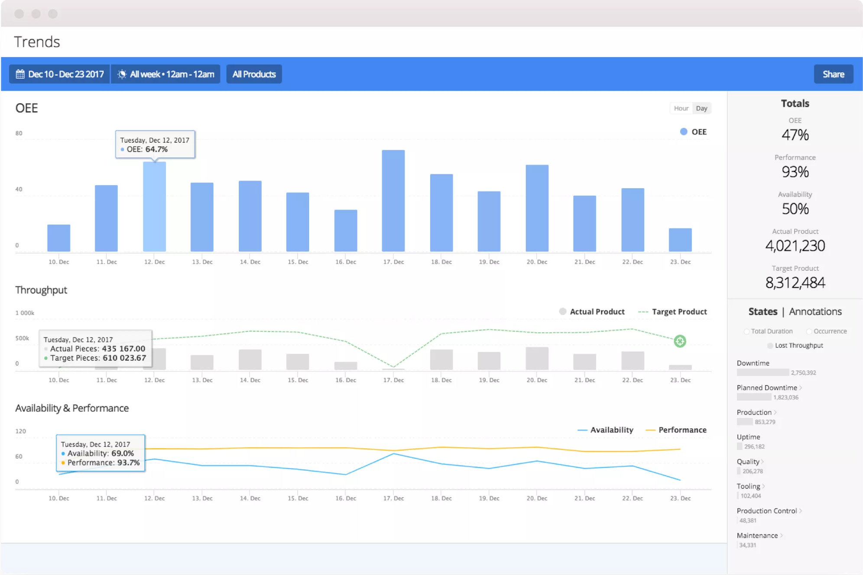
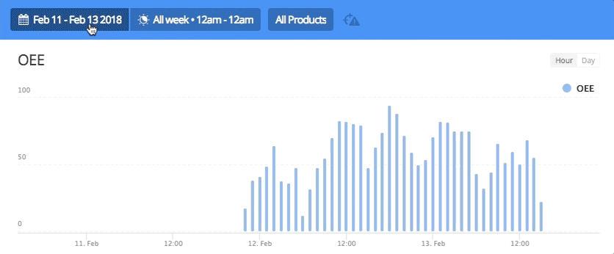
Interactive Time-series Analysis
Compare performance across different equipment.
Visualize hourly uptime and key custom metrics.
Calculations for analyzing and optimizing factory performance.

Slide 14
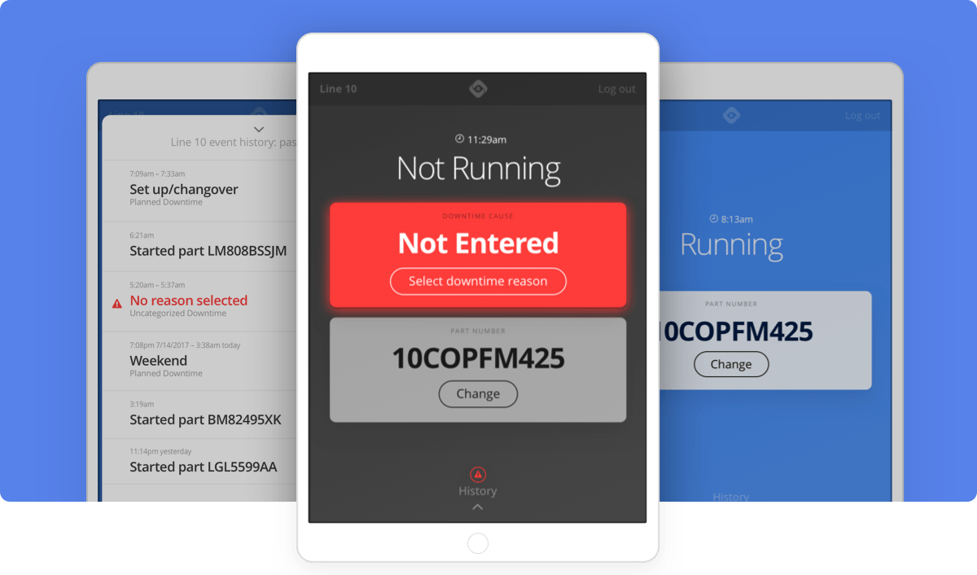
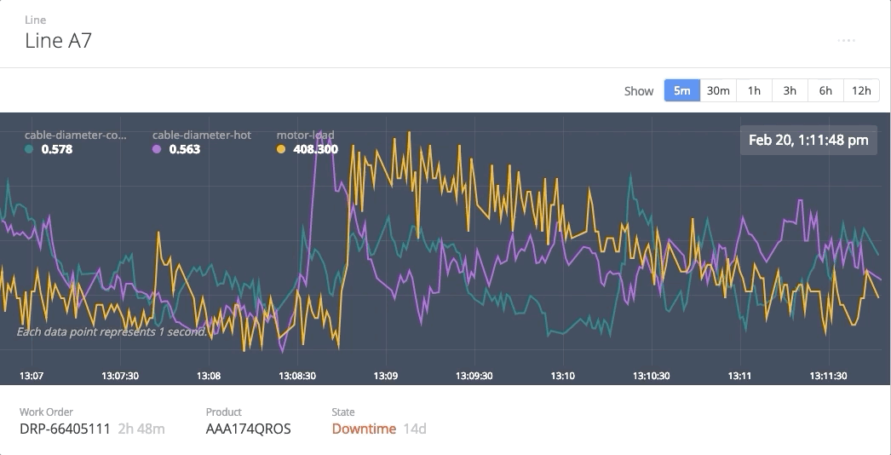
Real Time Manufacturing Data
Streaming second-by-second metrics
Interactive app that prompts on production state changes and collects user input.

Slide 15
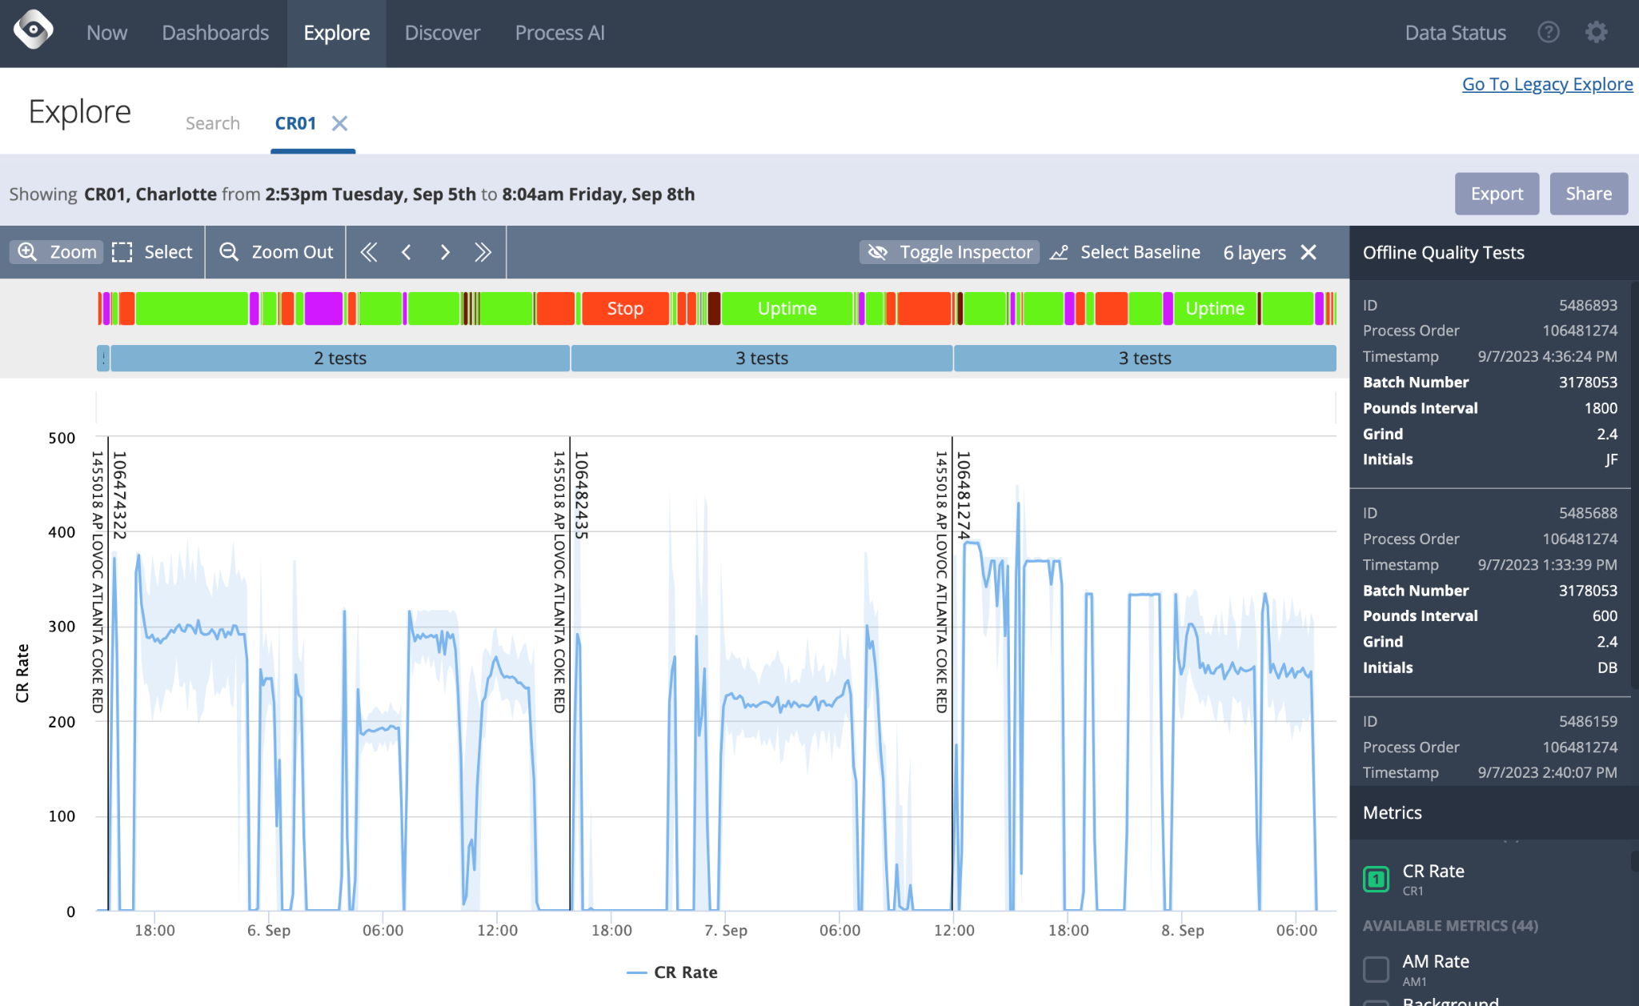
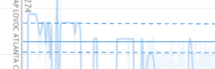
Data Contextualization
Oden Data Engine
Offline Quality Tests
Machine States inferred from Streaming Data
Production Data
Streaming Machine Process Data
Performance Targets

Slide 16
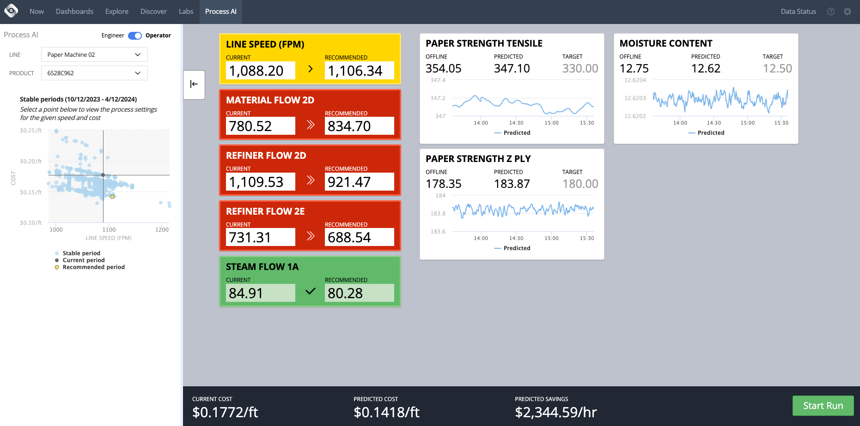
Process AI: Real-Time Operator Recommendations
Real-time predicted quality metrics
Metrics for the operator to adjust to fit desired range
Overall goals and progress

Slide 17
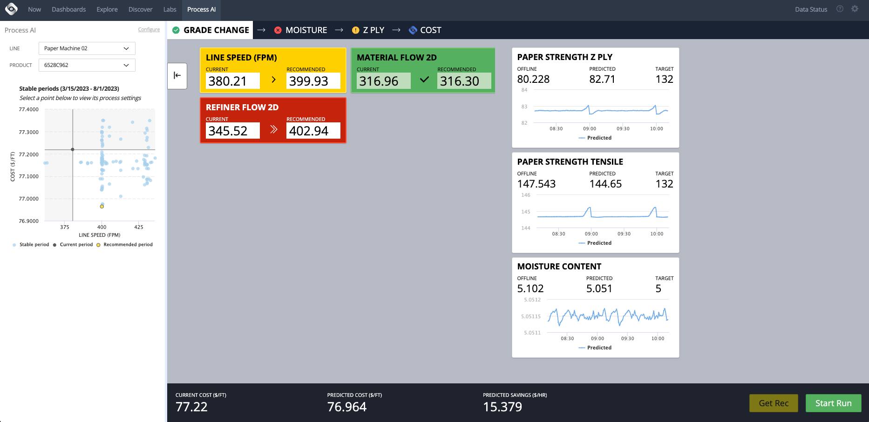
Process AI: Incremental Recommendations for Paper
Notes:
Here is a Process AI Operator View for a paper manufacturer with a 4-step process for optimizing their process. This was developed with Oden after we understood the customer’s goals and process in-depth, and were able to configure this in the software to align with a repeatable, attainable approach to get the end result desired. You can see that the slide has a number of items greyed out or renamed; this is an actual screenshot of one of our customers’ live system, as we wanted to show you it in action, but we have anonymized any sensitive information.
Ultimately, the goal is to maximize total machine output that meets grade specifications. In order to achieve maximal output, the operator must quickly be able to get on spec for all quality characteristics, the efficiently ramp up to maximum speeds with sustainable quality.
To accomplish this, the system first selects a historic set of process settings that are best suited for meeting moisture targets. This is based on AI-based process models we have trained that determine how changes to the process will moisture and other quality characteristics. These models also allow for continuous, real-time quality predictions so the impact of changes to settings such as steam pressure can be observed instantaneously.

Slide 18
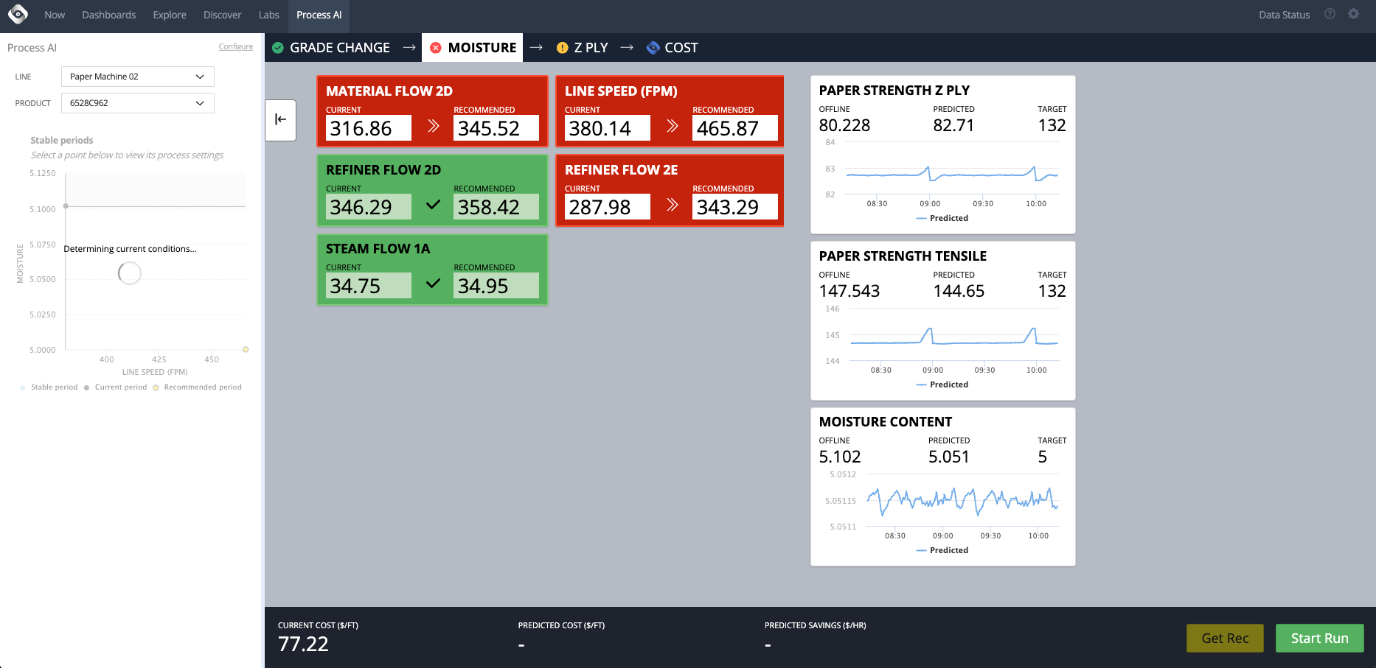
Process AI: Incremental Recommendations for Paper
Notes:
Once moisture is stabilized by adjusting steam pressures, Moisture and Z ply are the next goal. In this step there are a series of different settings to adjust. The colour coding indicates to the operator where to prioritize their efforts based on how out of sync they are with the recommended values to achieve the desired outcome quality and speed.

Slide 19
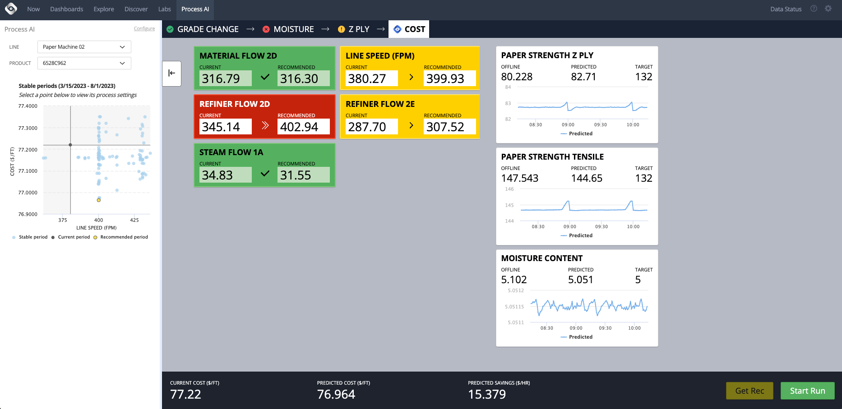
Process AI: Incremental Recommendations for Paper
Notes:
Once stability is established for the 3 quality metrics the goal is to increase machine speed. Rules are established to recommend incremental increases to speed as long as stability conditions are met. Process AI will continue guiding towards increased speed as long as these stability checks are maintained and until pre-defined stopping conditions, such as machine limitations, are met.
If any quality characteristics become at risk, the system will automatically move to the appropriate stage to further optimize that condition. You can actually see this happening on the screen right now, as moisture is falling out of spec, and so the operator will be pushed back to the first step in the process to get that back into an acceptable range, before moving back towards increasing speed.

Slide 20
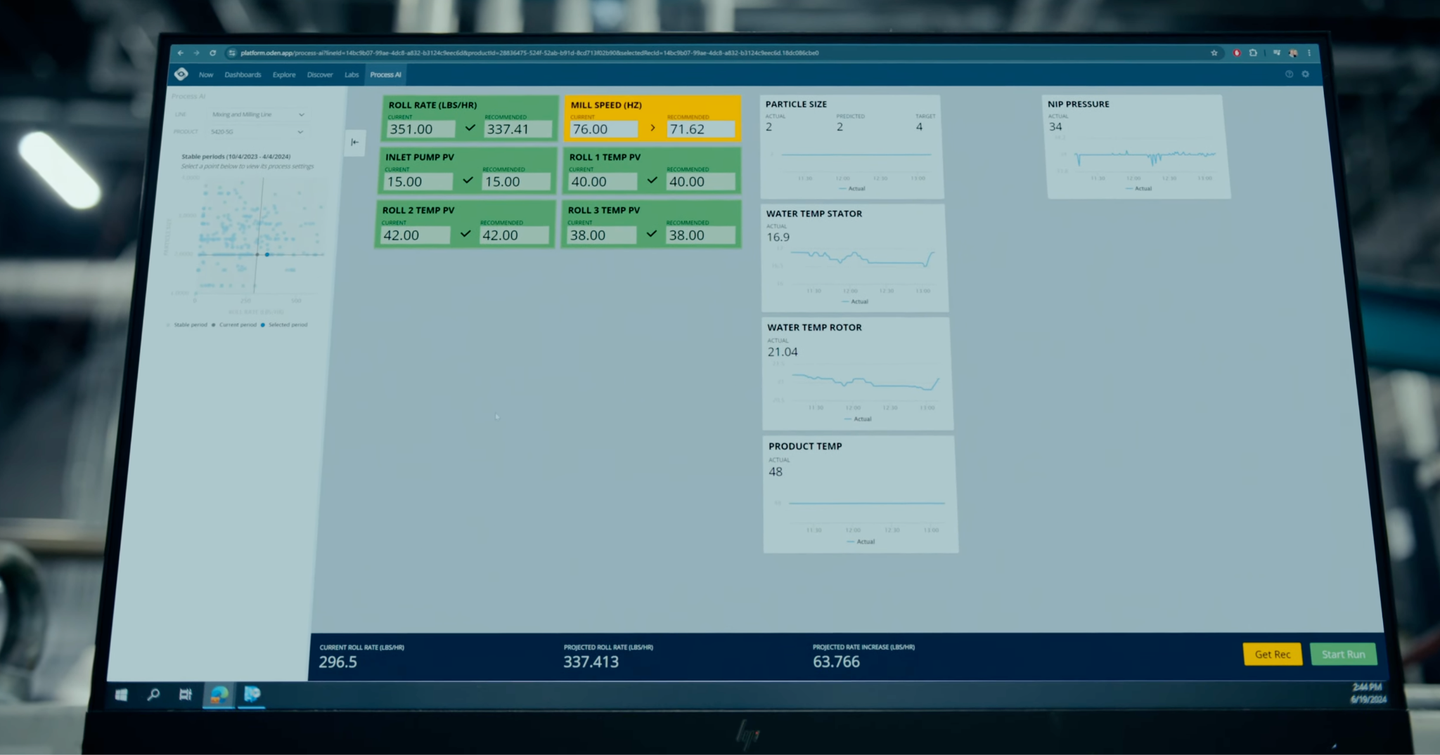

Slide 21








AI/ML Techniques used in the Oden Product Suite
Linear Models
Tree Models and Ensembles
Uses: Predictive Quality
Benefits: Interpretability, fast, easy to train, scalable
Oden uses a variety of different approaches (LASSO, Elastic Net, PCA-Regression) to predict quality metrics. These are powerful as all of the model variables can be visualized and trust is built.
Oden also uses Deep Learning and other models for PQ problems to validate results.
Uses: Predictive Quality, Root Cause Analysis
Benefits: Interpretability, non-linear separations, handling categorical data
Used to identify key contributors separating periods of interest from baselines, i.e. changeover detection
Artificial Intelligence (AI)
Machine Learning (ML)
Deep Learning (DL)
Artificial Neural Networks
Optimization Models
Deep Learning and Large Language Models
Uses: Process AI Recommendations
Benefits: Solve complex multi-objective multi-constraint problems
Oden uses optimization models to provide process setting recommendations directly to operators in real-time.
Uses: Stable Periods, Knowledge AI [in development]
Benefits: Powerful learning
Oden uses Deep Learning models for Stable Period analysis for Process AI, as well as in exploratory work with Knowledge AI and providing work instructions.
Notes:
Elastic Net - Great for minimizing coefficients of non-important features
GBR - Can capture non-linear relationships, ex. Temperature and Humidity, we know there’s a non-linear relationship.

Slide 22
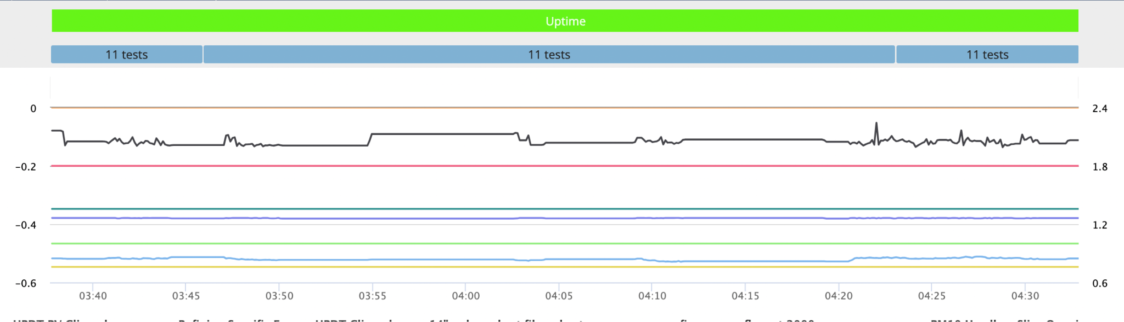
Problem Statement: Predictive Quality
Use multi-dimensional time series signatures:
To predict a single quality test label at the end of each run:

Slide 23
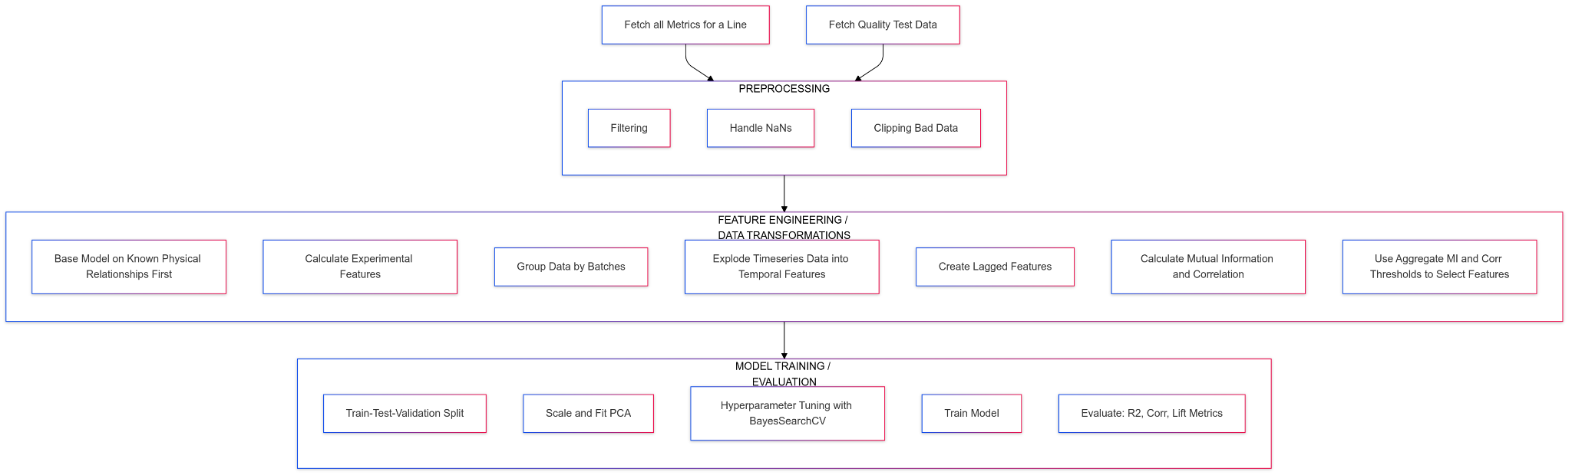
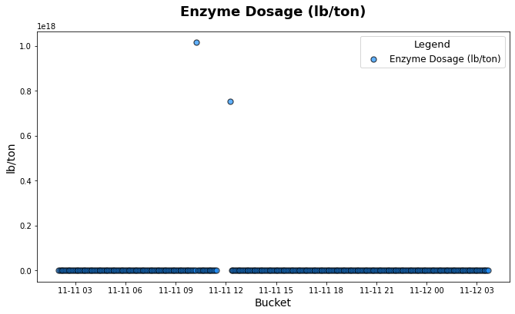
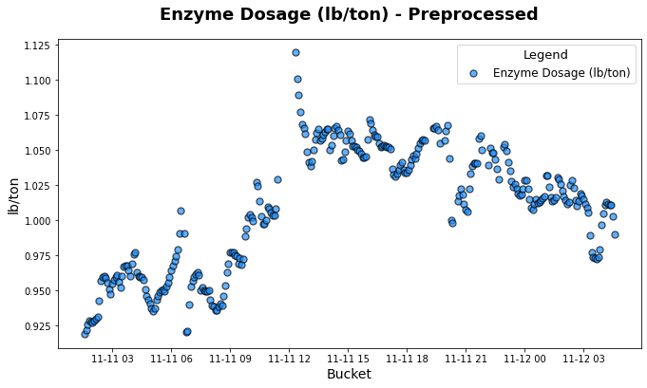
Example PQ Pipeline - Preprocessing
Notes:
Shoutout Mermaid!

Slide 24
Example PQ Pipeline - Feature Engineering

Slide 25
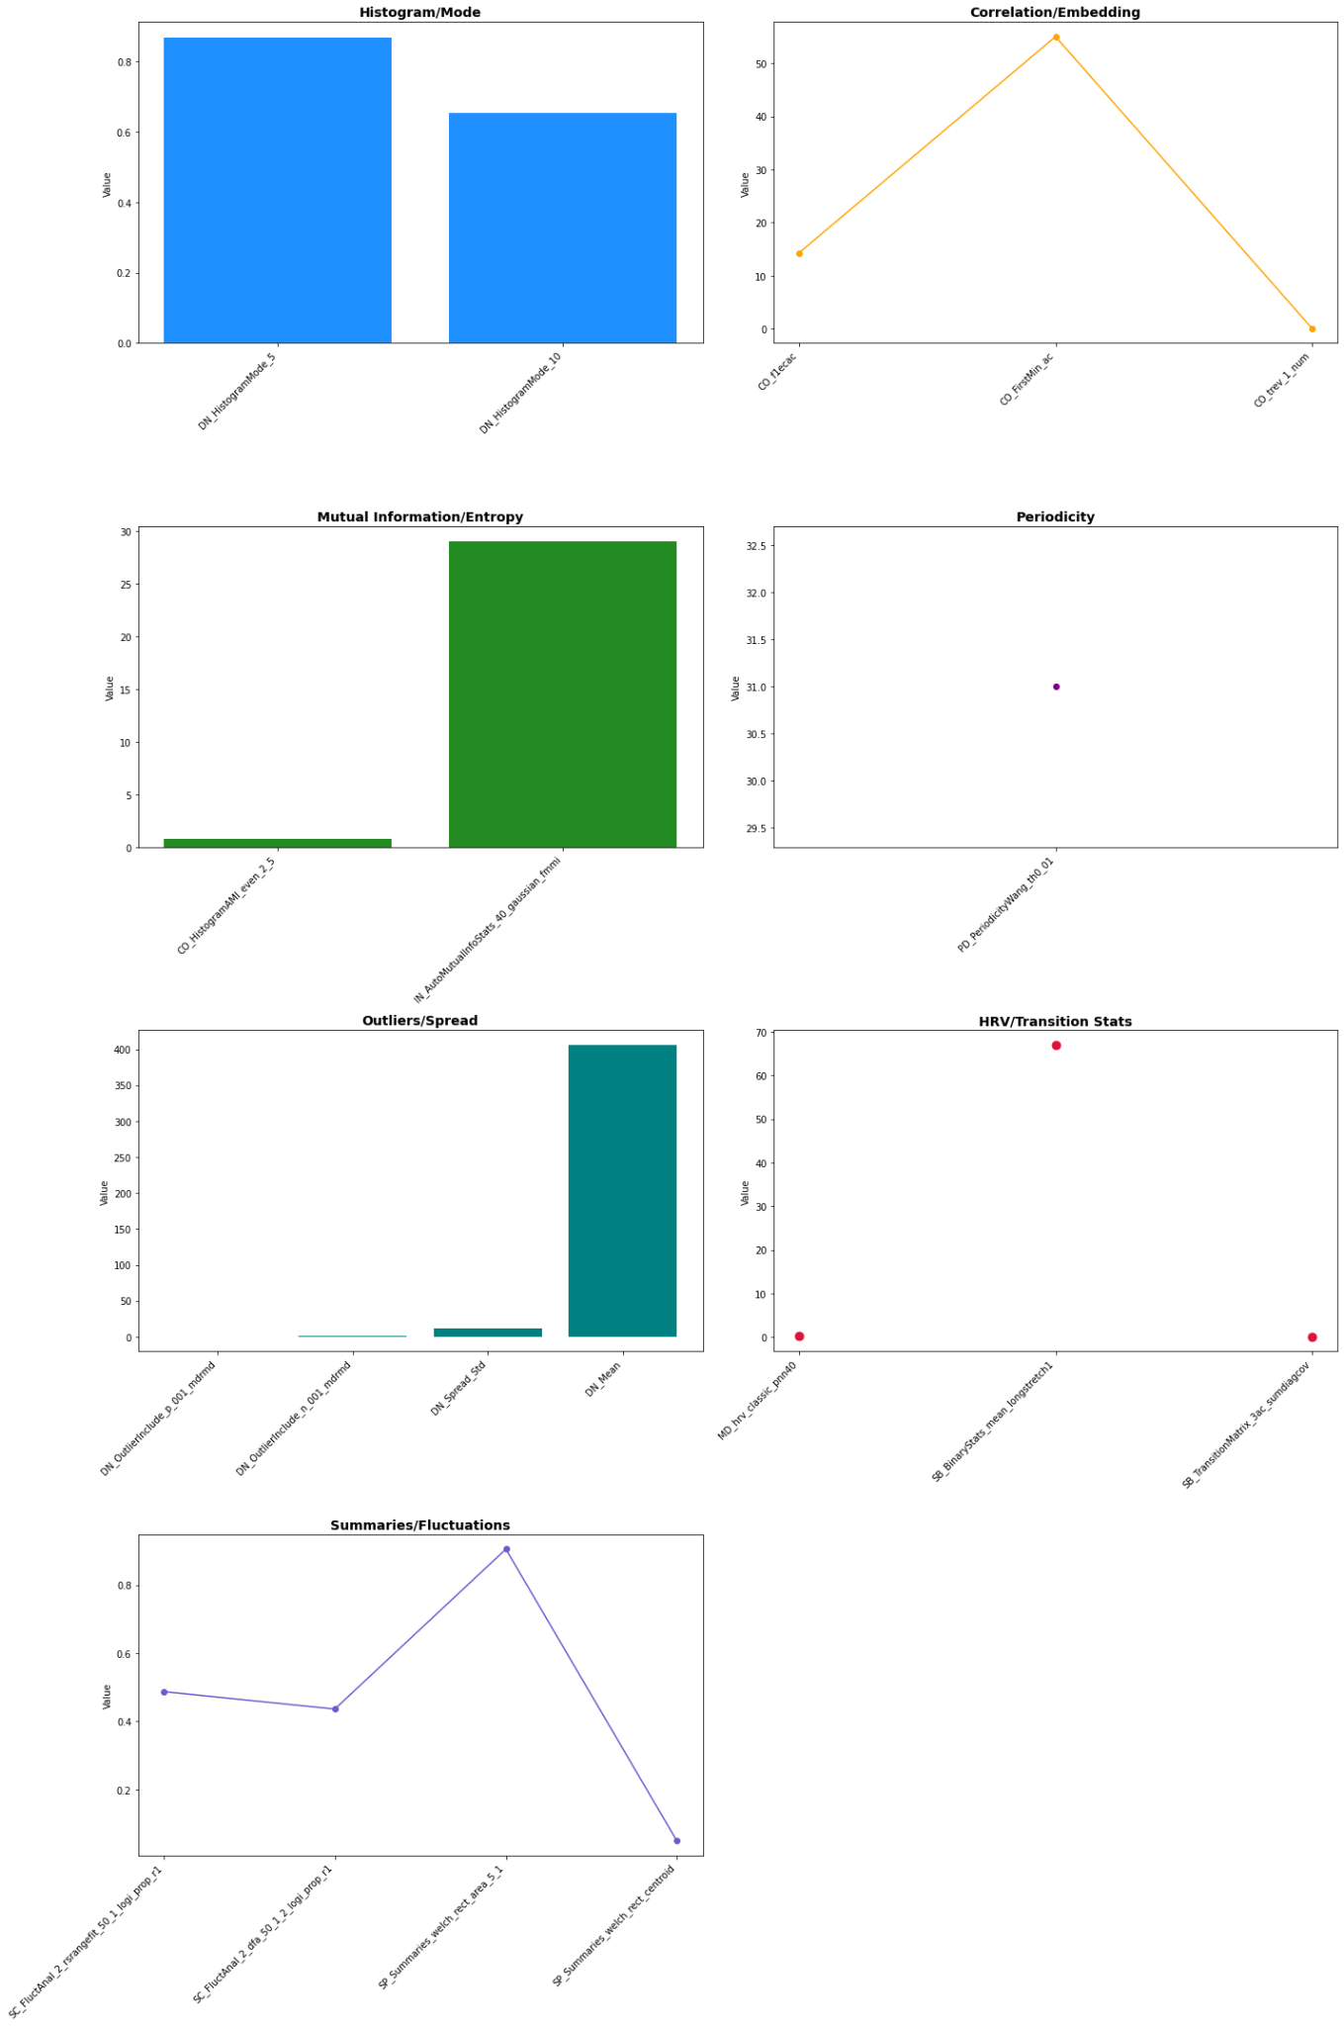
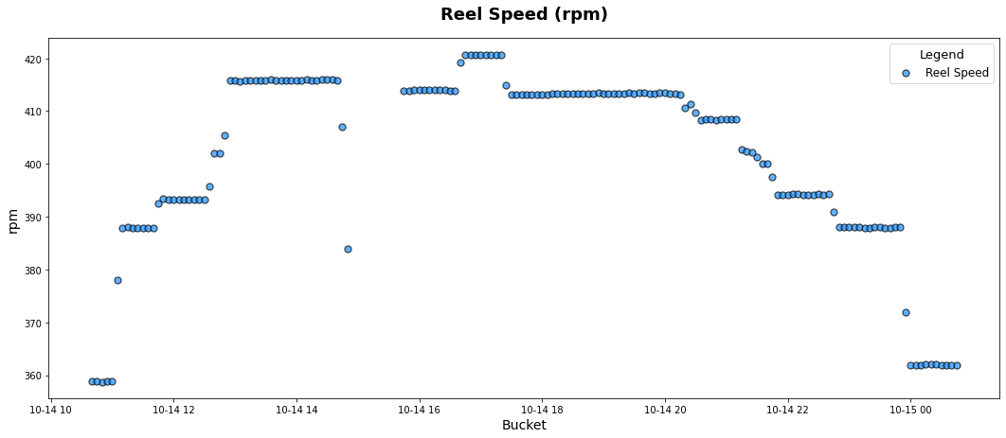
Example PQ Pipeline - Feature Engineering
Time Series Decomposition into Core Stats
Source: catch22: CAnonical Time-series CHaracteristics
https://link.springer.com/article/10.1007/s10618-019-00647-x

Slide 26
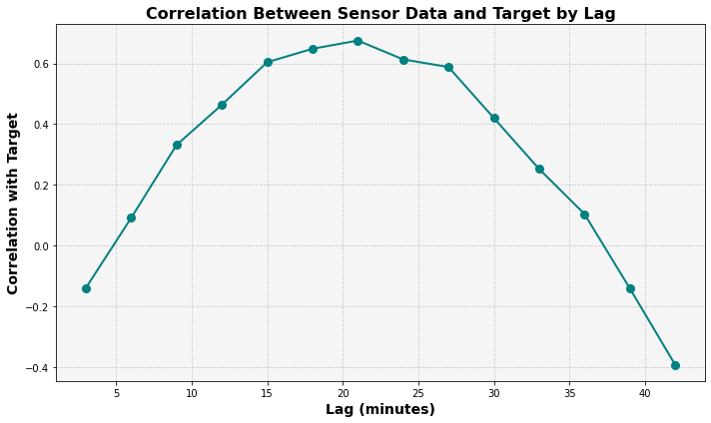
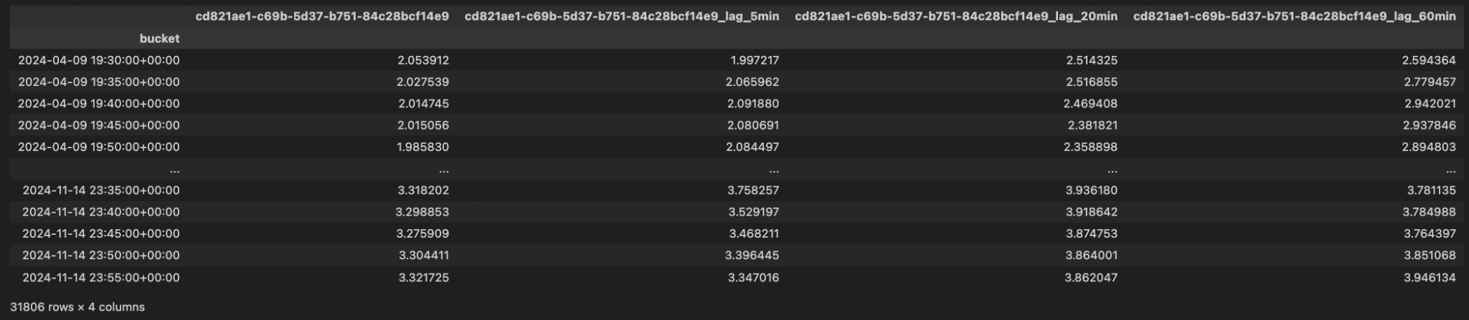
Feature Selection and the Lag Effect
A change in one metric may not impact output quality for N minutes.
How can we find N?
If available, ask a Domain Expert!
Otherwise, we can estimate this with lagged features, and ranking metrics (e.g. corr)

Slide 27
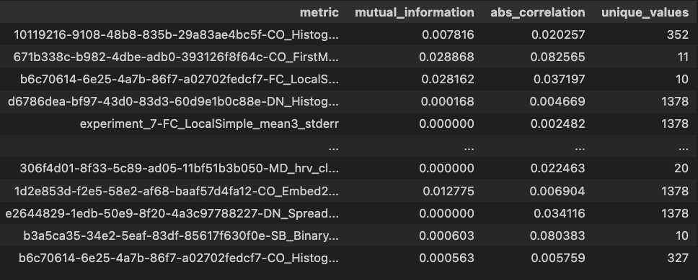
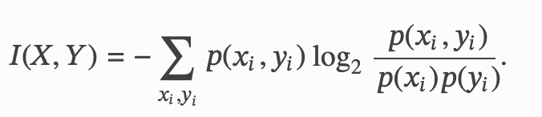
Feature Selection and Ranking Metrics
Feature Space:
-> 100’s to 1000’s of raw &
transformed metrics
Systematic Filtering Methods:
Human-In-The-Loop
Feedback (Physics-Based/ State-Space
Modelling)
2. Mutual Information/ Absolute Correlation Scores
3. Concentration of Noise/“Bad Data”, nunique(), etc.
-> from sklearn.feature_selection import mutual_info_regression
-> pd.Series.corr(labels)
-> pd.Series.nunique()
Notes:
Mutual information - shared information between two random variables.

Slide 28
Example PQ Pipeline - Train/Deploy

Slide 29



Example PQ Pipeline - Train/Deploy
Dataflow

Slide 30
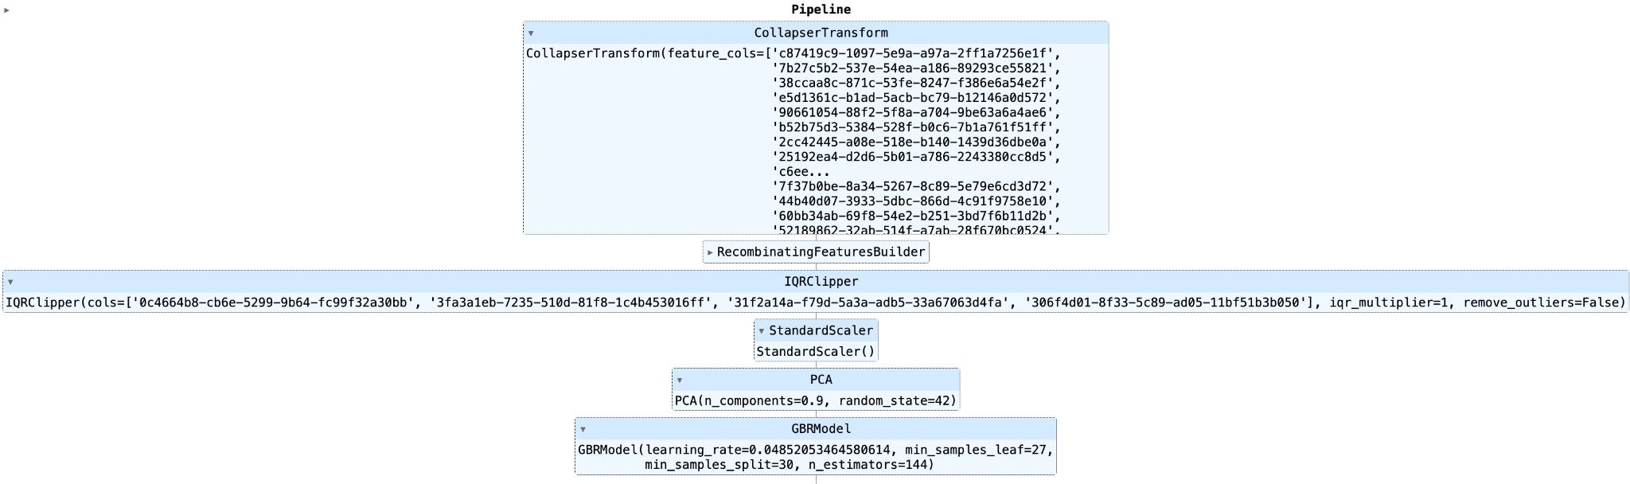
Example Pipeline - Registered to MLFlow

Slide 31
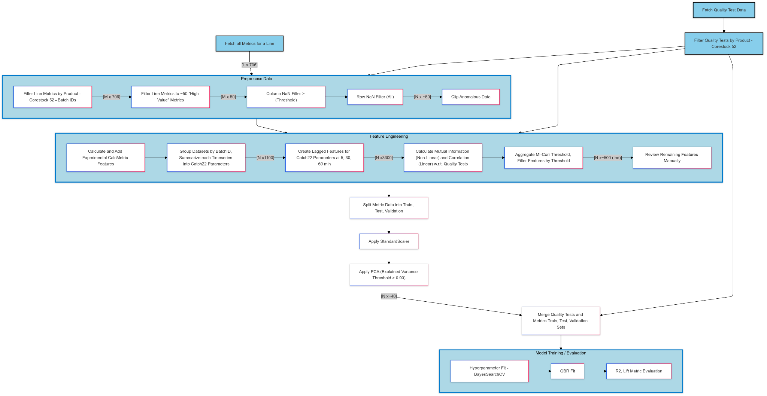
Sample Pipeline

Slide 32
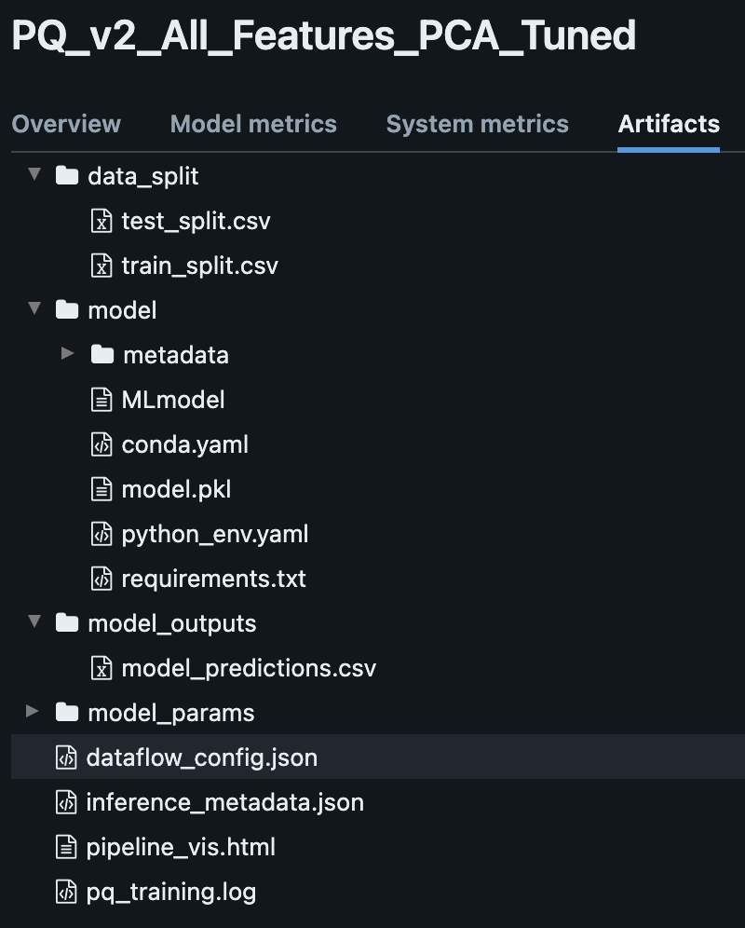
MLFlow Artifacts

Slide 33
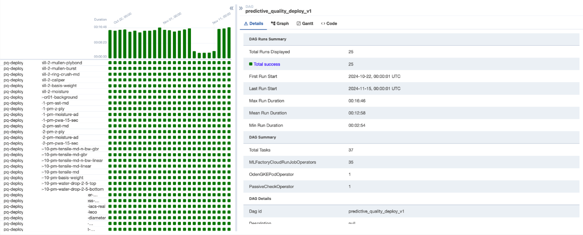
Model Deployment via Apache Airflow

Slide 34
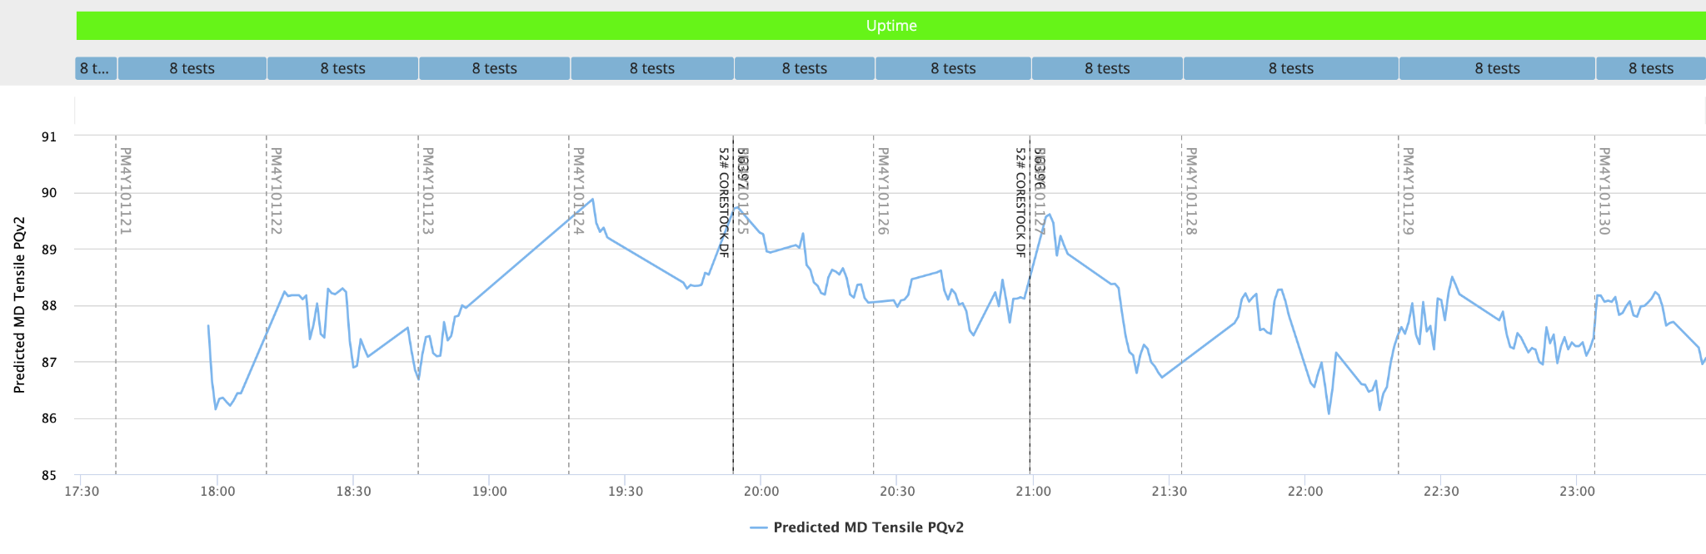
Real-Time Predictions with Dataflow (Google Cloud)
DataFlow job manages real-time inference/ posting predictions to the Oden Platform

Slide 35
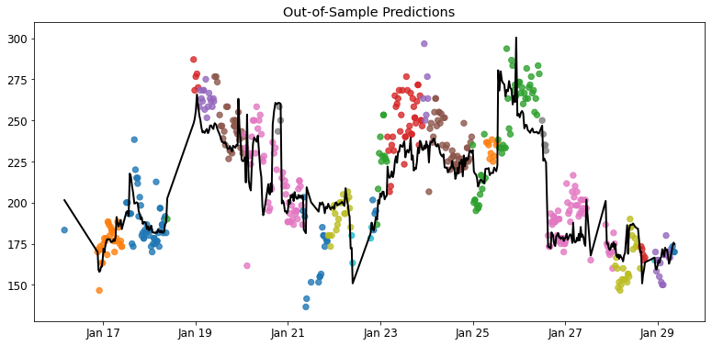
Key Variables Example: Paper
Predictive Quality Model Development
Ply Bond - Paper
Key Variable | Coefficient
#7 Vat Flow | -6.5224
#10 Vat Flow | -4.1779
Shared Waste Water | -4.0135
2nd Press Bottom Felt Vacuum | -3.5552
Bone Dry Weight (scanner) | -3.3621
Production Rate (tons/hr) | -2.8738
D Refiner HPDT | 2.2074
1st Dryer Section Speed | 2.988
C Refiner KW | 3.1313
C Refiner HPDT | 3.1394
% Target | 3.5729
#1 Vat Lvl Output | 3.5746
D Refiner KW | 4.0107
Total HPDT | 8.8416
>90% accuracy | >70% correlation | <3 sigma error
Total Process Variables: 127
Model Variables: 38
Key Variables: 14

Slide 36
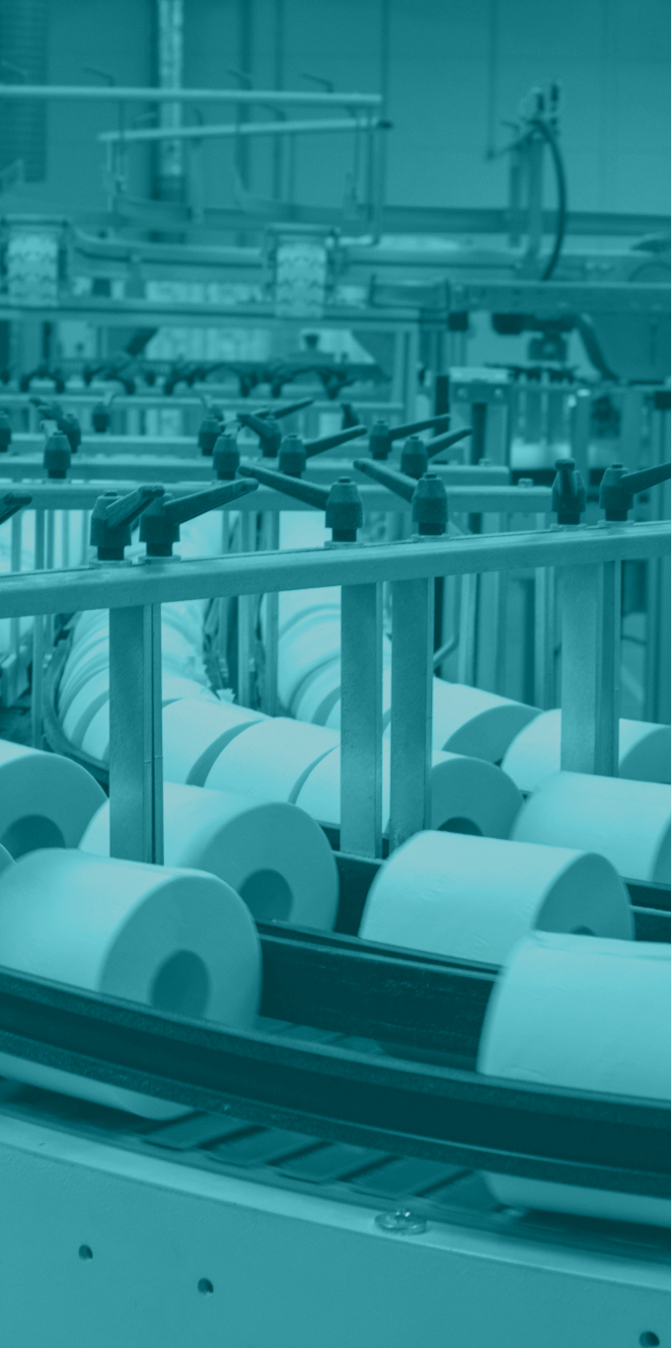
Tangible Results for Pulp & Paper
Fortune 500 Paper Customer
Goal: Optimize speed & reduce input Costs while
maintaining quality
Solution: Oden Process AI + Data Engine, first 6 months
3%
Increase to Line Speed
($440K benefit/year)
$900K+
5%
Reduction in Material & Energy Costs
($505K benefit/year)
Savings / Year
Notes:
Results

Slide 37

Tangible Results for Wire & Cable
Customer: #1 Electrical cable producer in North America
Goal: Increase production through higher line speeds
Solution: Oden Process AI
When: 90 days from go-live
Scope: 2 extrusion lines, many products
Who: 20 Operators of varying experience
Results:
+20%
+5.3Mft
Increase in
Production Rate
Additional Feet Produced over 90 days

Slide 38
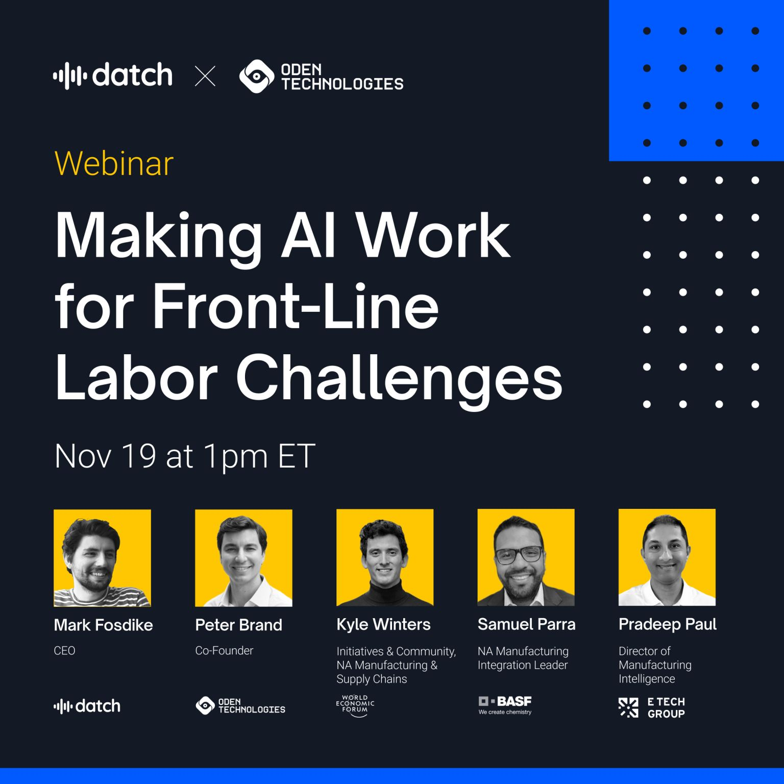
Thank You!
oden.io
joseppy.ca

Slide 39
SQL vs. OQL (Oden Query Language) Comparison
Query: Daily Factory Performance Over Last 90 Days
TRADITIONAL PROCESS
ODEN QUERY LANGUAGE
User
Data Engineer + Domain Expert
User
Engineering & Operations
Time
1+ hour
Time
10 – 30 Seconds
SQL
OQL
SELECT
Day,
i.factory_name,
sum(output)/sum(target) as performance,
(WITH
TIMESTAMP_SUB(CURRENT_TIME(), INTERVAL 90D) as start_time,
CURRENT_TIME() as end_time,
intersections as (
SELECT * FROM (
SELECT s.start_timestamp, s.type, null FROM states s
WHERE s.start_timestamp BETWEEN start_time & end_time UNION ALL
SELECT r.start_timestamp, null, r.product FROM runs r
WHERE r.start_timestamp BETWEEN start_time & end_time
) INTERPOLATE (s.type as s.type, r.product as r.product)
),
factory_lines as (
SELECT id FROM lines WHERE factory_id = ‘a82f9f08-1e97-4328-adfc-5869069c0091’
SELECT
i.start_timestamp,
TIMESTAMP_TRUNC(i.start_timestamp, DAY) as Day,
i.factory_name,
(avg(m.value) * (i.end_timestamp - i.start_timestamp)) as output,
avg(t.target) as target,
FROM metrics m
ASOF JOIN intersections i ON m.line_id = s.line_id & m.timestamp >= s.start_timestamp
JOIN targets t ON i.line_id = t.line_id & i.product = t.product
WHERE s.type = "Uptime" & m.id IN (
select id from metric_definition where line_id IN (factory_lines) & m.metricgroup_label = ‘performance’
)
GROUP BY s.start_timestamp, i.factory_name)
GROUP BY Day, i.factory_name
Aggregate aggregation.performance*100 as performance
where factory.id = ‘ a82f9f08-1e97-4328-adfc-5869069c0091 ‘
& time from now () – 90D to now()
group by factory.name, bucket 1D
Requires database query language expertise
Time-consuming trial & error
Limited to few users
No-code query exercise for user
Immediate insights lead to adaptable query
Ops-centric view without process engineer
Complex systems lead to inaccurate & abandoned initiatives
Oden provides the most flexible real-time platform for the manufacturing ecosystem

